Slide 1
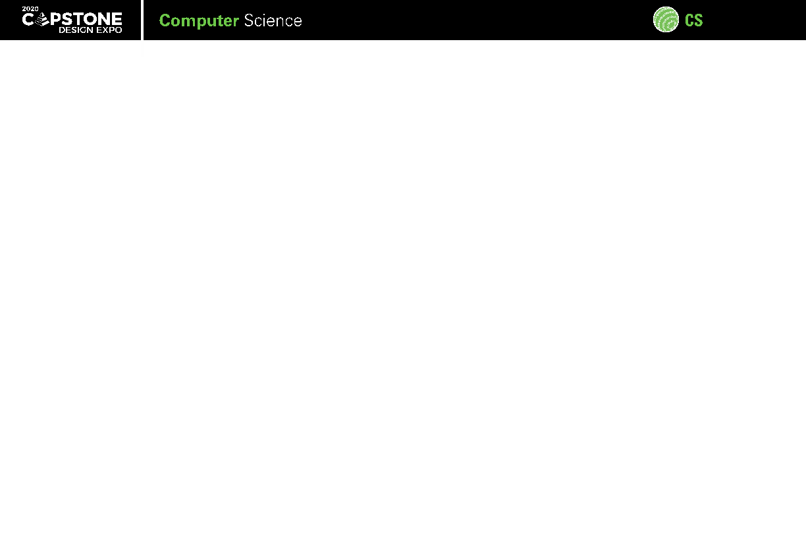


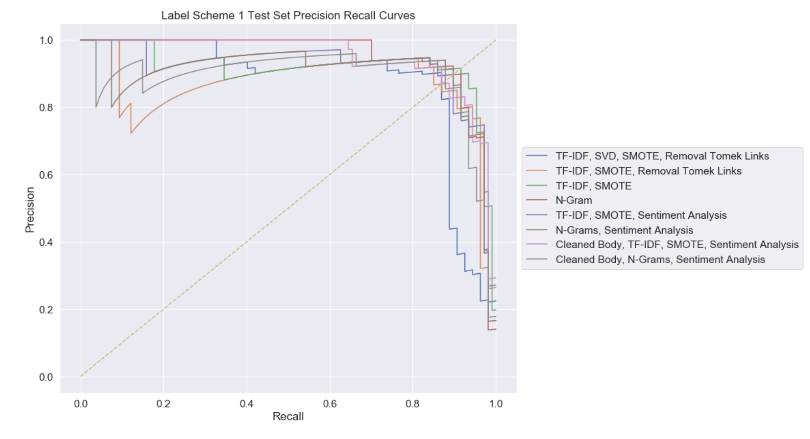
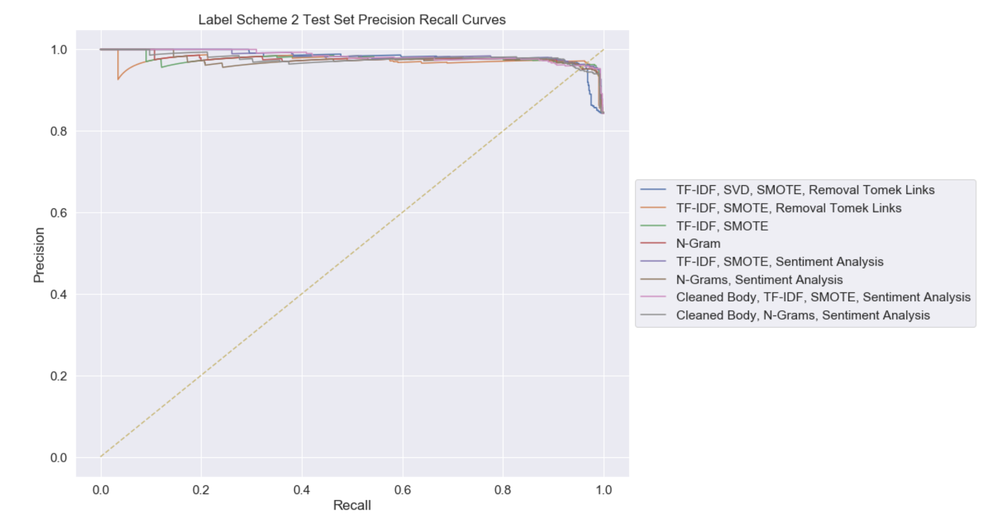
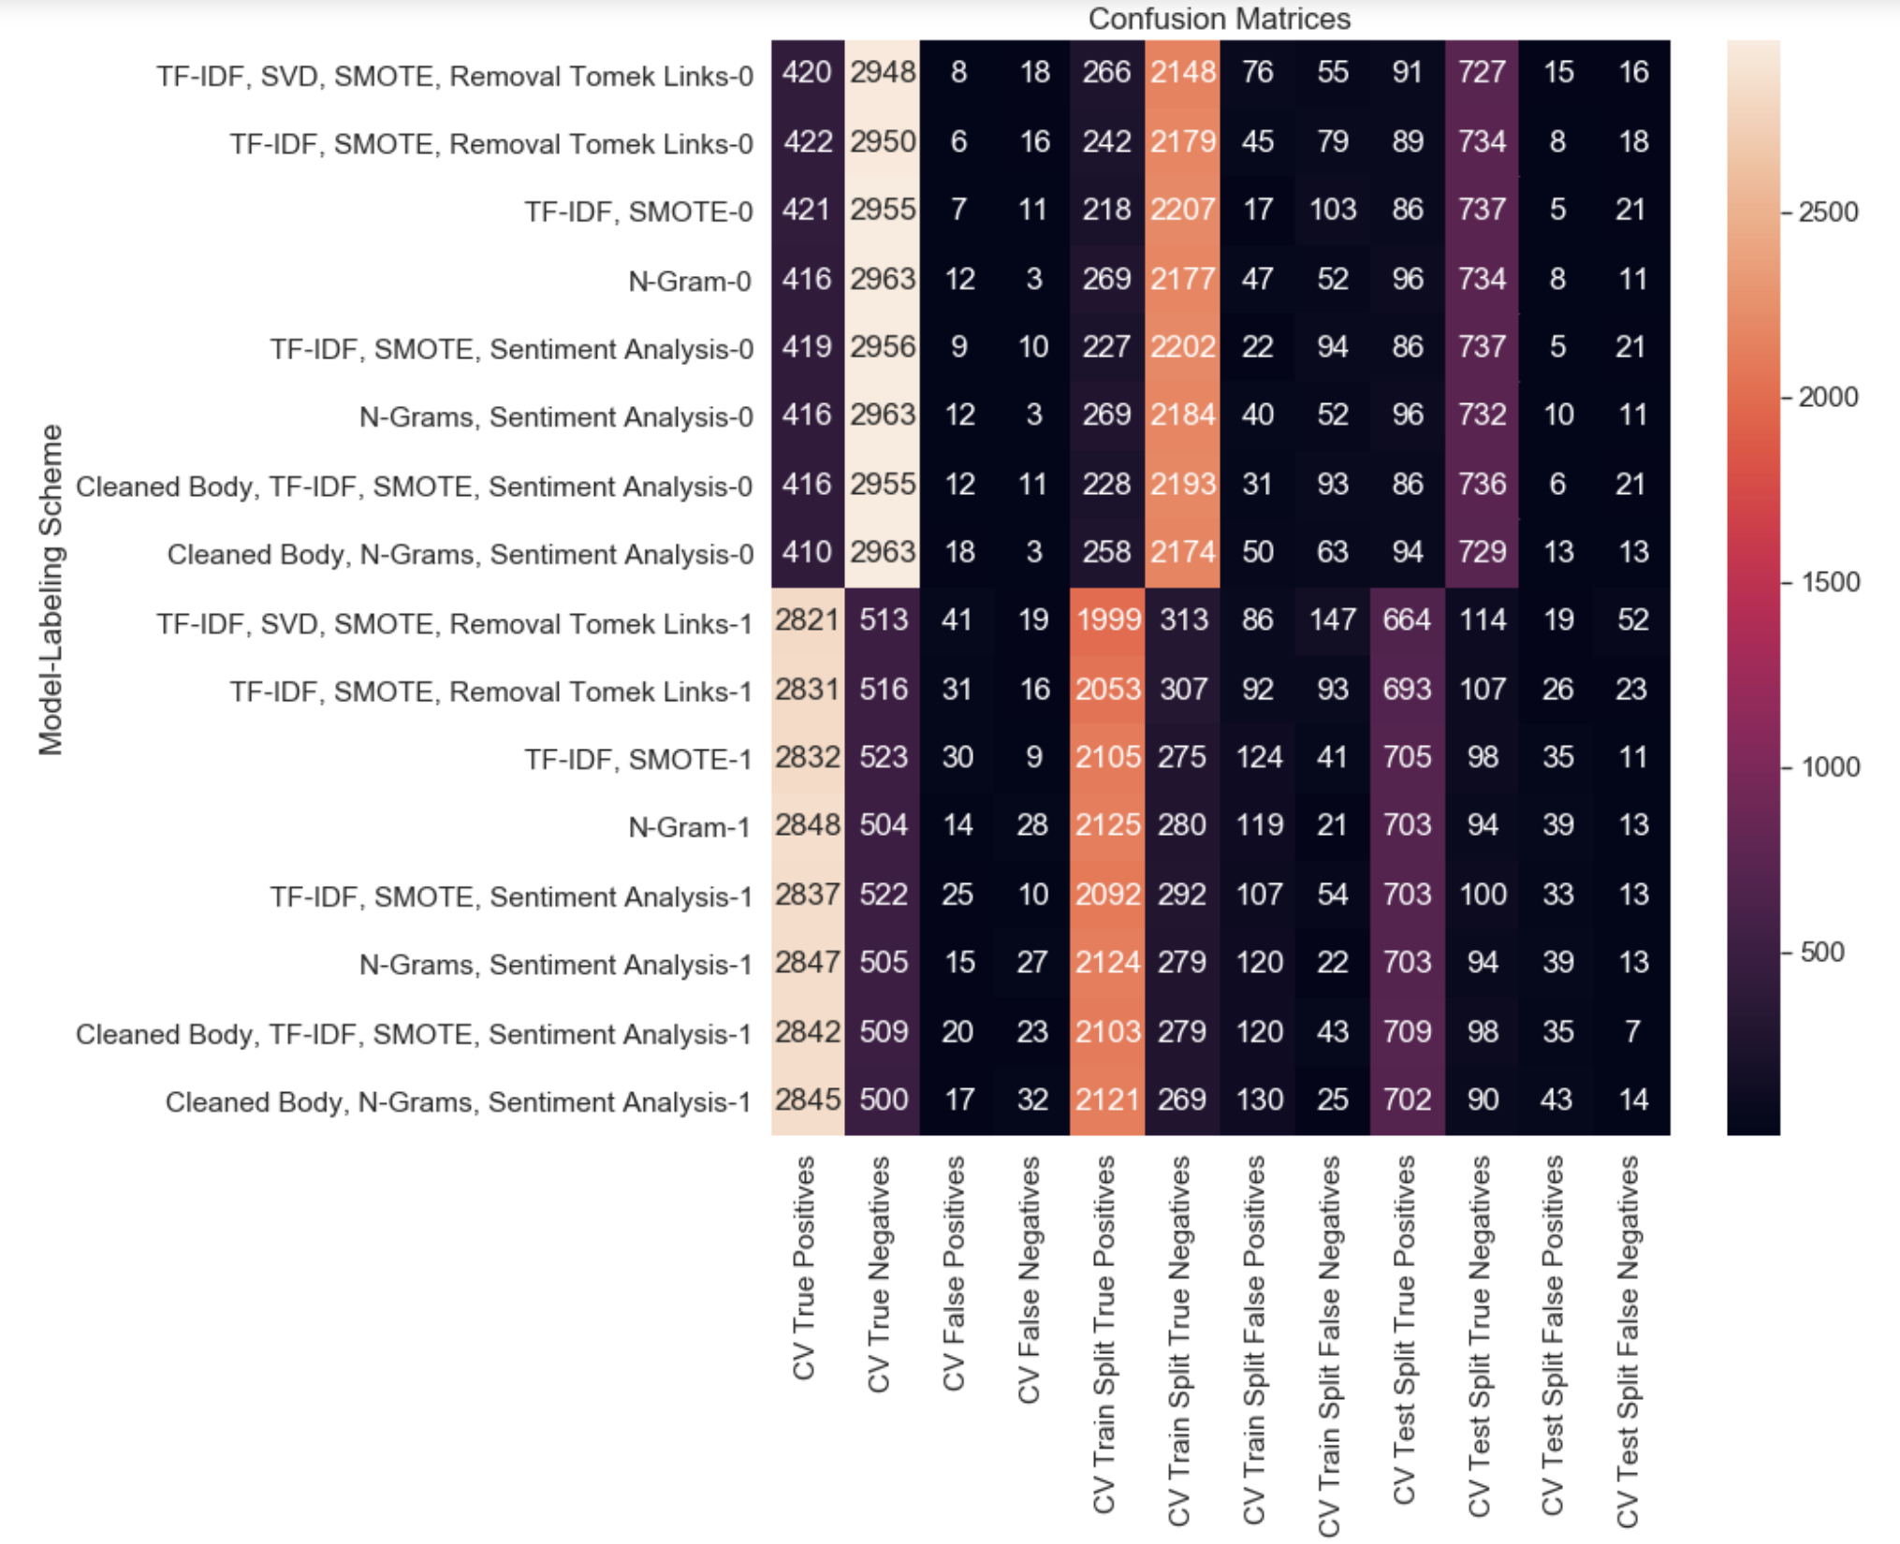
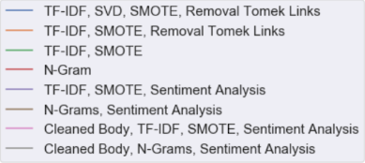
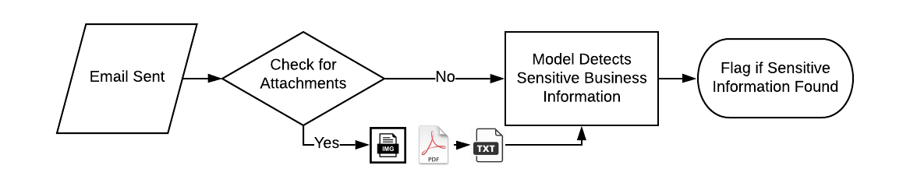
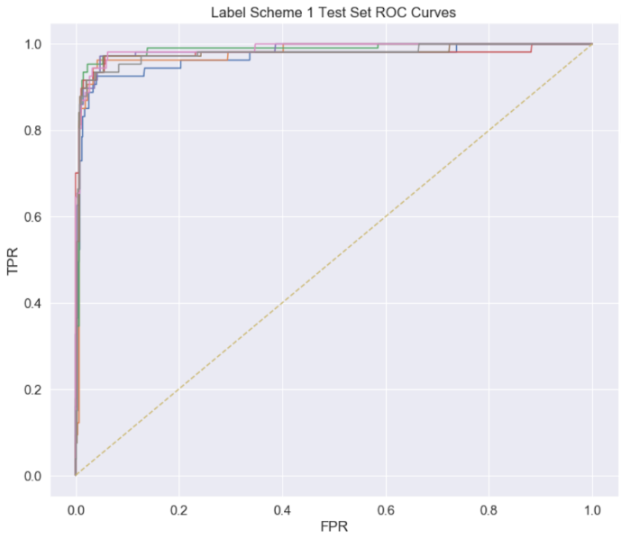
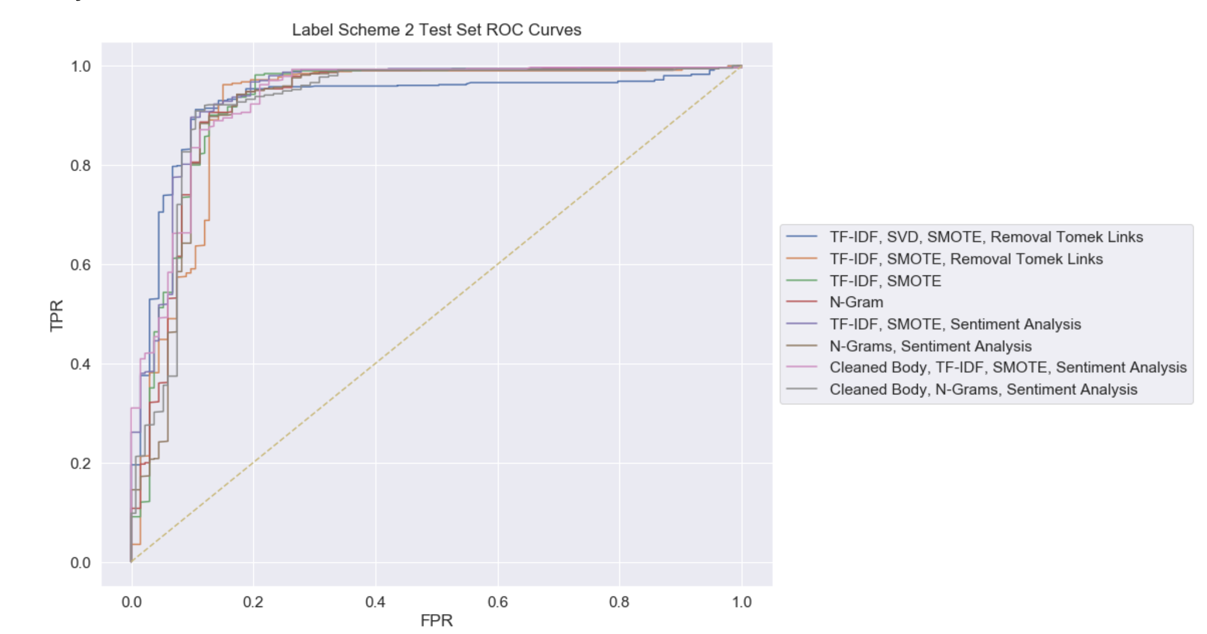
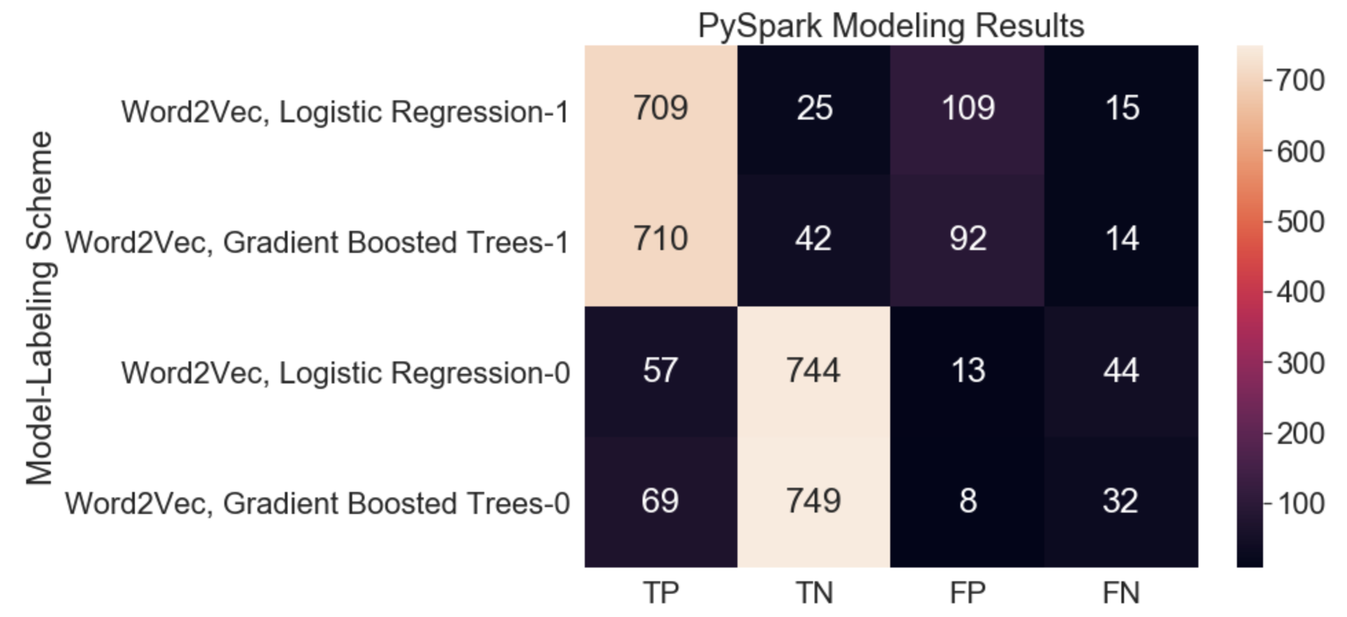
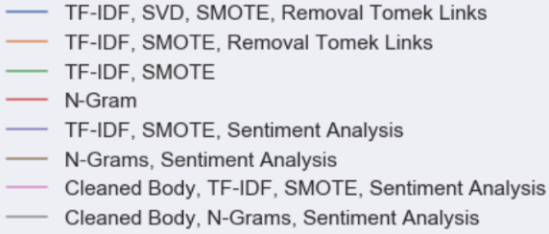
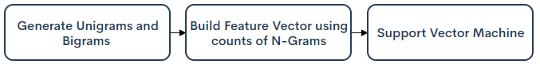
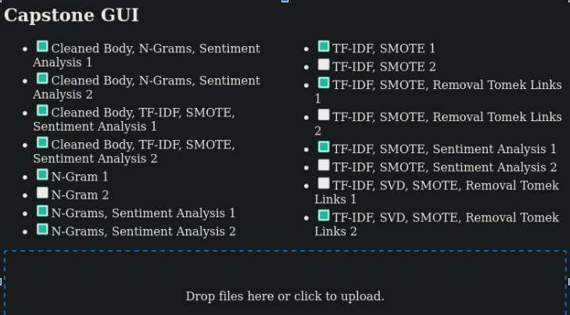
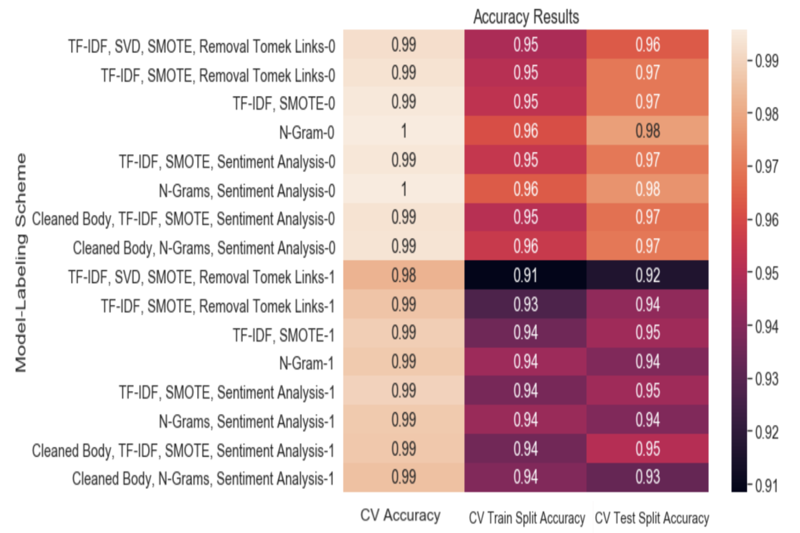
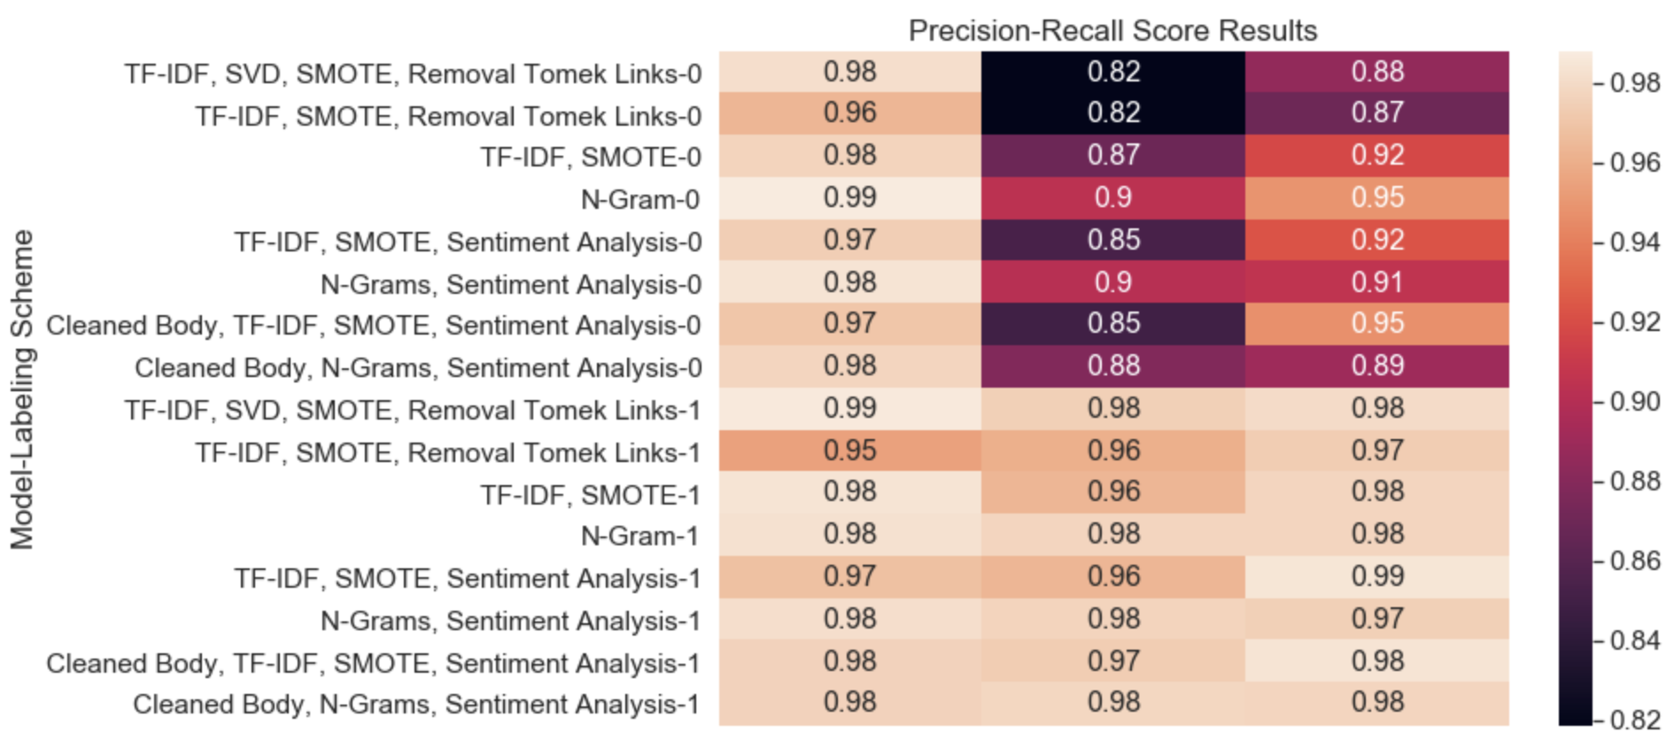
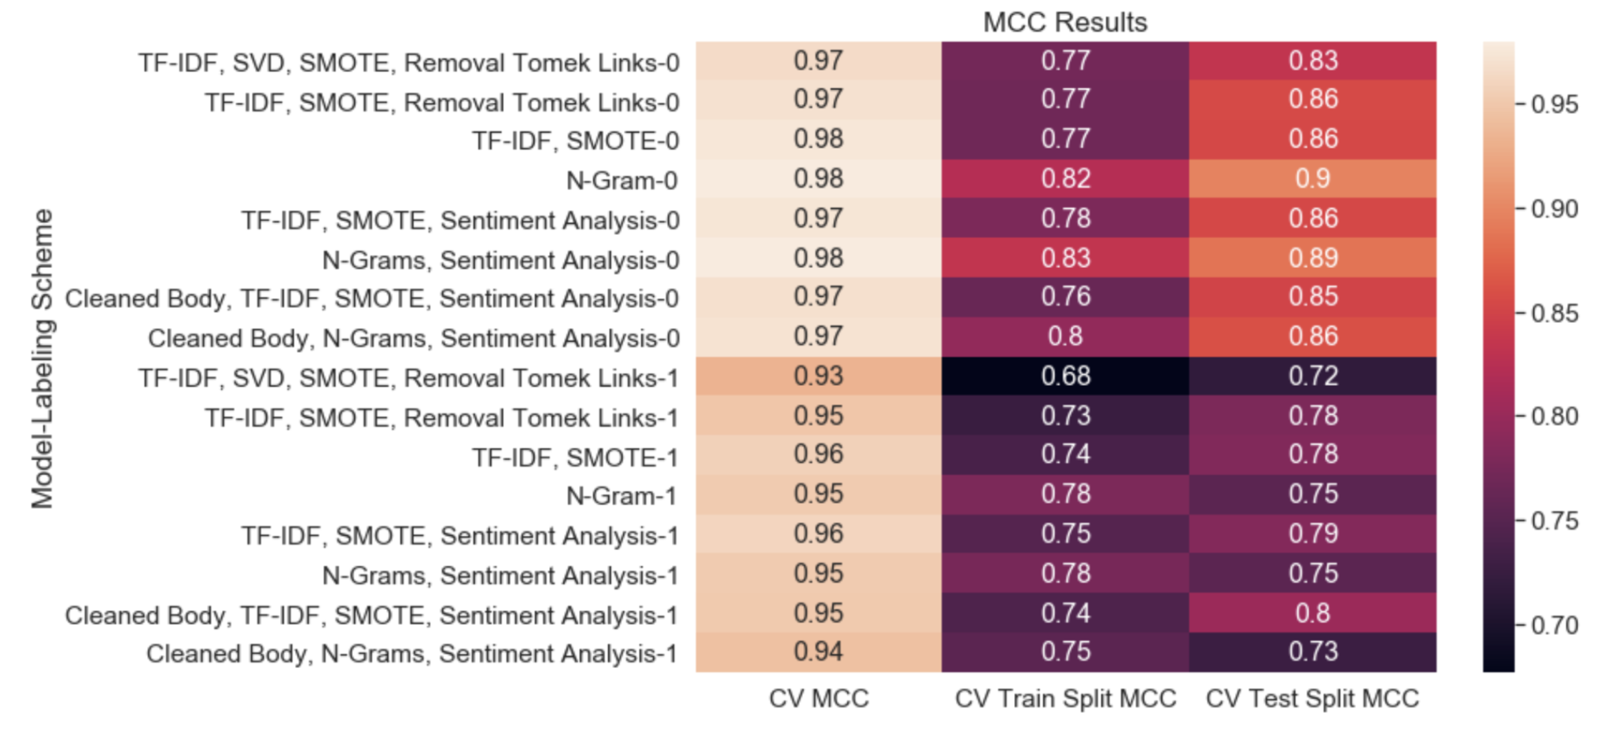
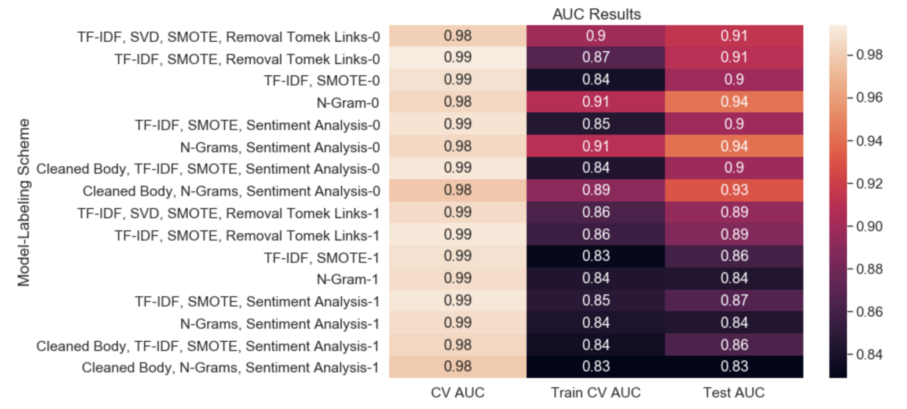
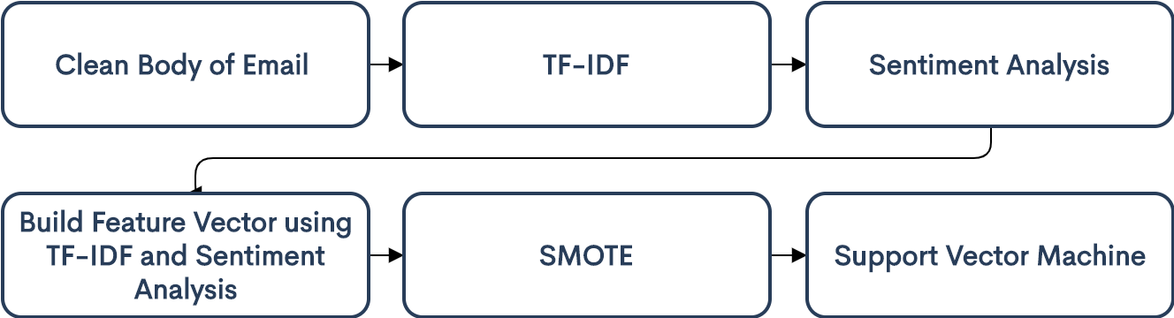
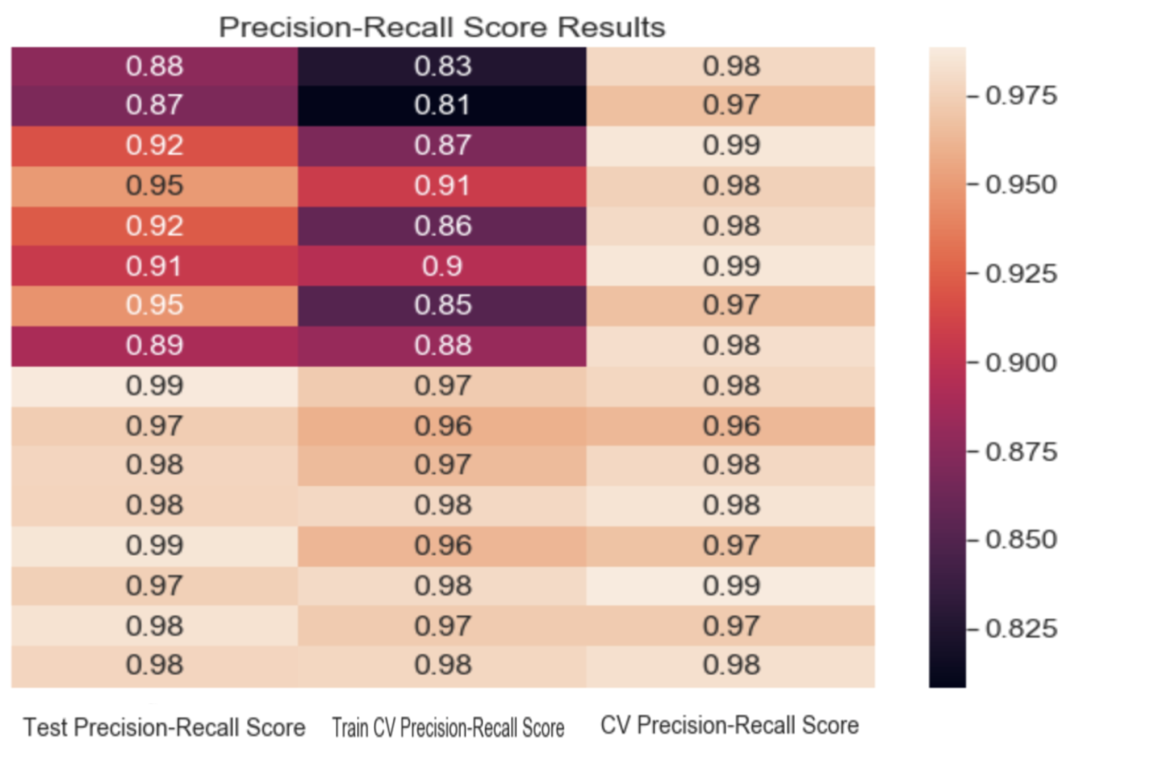






316
Email Content Anomaly Detection
Team members: Bharat Venkat, Jeremy Bailey, Liam Fernando, Mohammad Malik Faculty adviser: Changqing Luo | Sponsor: Capital One | Mentor: Nahid Farhay, Ana Cruz
Modeling and Sampling
Problem Definition
Final Results
DataInitial Problem
Sampling
SMOTE
Removal of Tomek Links
Modeling
SVM, Gradient Boosted Trees, Logistic Regression, LSTM
Grid Search for Parameters
Evaluation
5 Fold Cross Validation over Entire Dataset
5-Fold Cross Validation over 75% Training Set
Holdout 25% Test Set
The objective of this project is to create a tool to do email content scanning of externally sent emails, attachments (PDFs/images) and detect potential data exfiltration attempts.
Preprocessing
Preprocessing
Cleaning data using regular expression (Regex) parsing techniques
Feature Extraction
Ngrams, Word2Vec, Doc2Vec, TF-IDF, Regex, Sentiment Analysis, Word Embeddings
Tesseract implementation
ImageMagick
DataInitial Problem
Enron email dataset
Attempt to Inject sensitive data using Faker
Original data was 600,000 emails. Subset of 3,400 labeled emails were used.
Data
TP TN FP FN
TP TN FP FN
TP TN FP FN
CV CV Train Set Test Set
Labeling Scheme 1 Best Pipeline
GUI
Contains majority sensitive labels
Labeling Scheme 2 Best Pipeline
Contains any sensitive labels
Conclusion / Future work
Conclusion
Pros of using machine learning
Predictive performance
Choose labeling scheme based on use case
Integration into companies
Improved GUI
Benefits of using advanced tools
Extend to use Deep Learning

